Slide 1
Advanced Encryption standard
Rijndeal block cipher

Slide 2
Guided By…
Prof. Vivaksha Jariwala
Created By:-
Jalpan Randeri
Vivek Champaneria

Slide 3
Index
Introduction
Data Encryption Standard
Advanced Encryption Standard
Rijndael
Encryption Algorithm
Decryption Algorithm
Strength
Conclusion

Slide 4
Introduction
The Advanced Encryption Standard will be the new standard cryptographic algorithm for use by U.S.Goverment organizations to protect sensitive information.
Winner from 5 finalist is Rijndeal
AES and Rijndeal
Developer of Rijndeal Belgian cryptographers Vincent Rijmen and Joan Daemen .

Slide 5

Data Encryption Standard (DES)
The data encryption standard developed by IBM under the auspices of the United States Government.
The DES is a block cipher was selected by the National Bureau of Standards as an official Federal Information Processing Standard (FIPS) for the United States in 1976.
Insecure
Broken within the 22 hrs and 15 mins.
Need for new algorithm.

Slide 6

Advanced Encryption Standard (AES)
AES is a symmetric encryption algorithm processing data in block of 128 bits.
AES-128, AES-192 and AES-256
Background
Main Criteria of Strong Algorithm
Unable to find unencrypted text if key in unknown.
Two Properties
Brute Force
Long Range of Keys

Slide 7
Encryption must be done properly
Strong Keys
Security

Slide 8
Rijndeal
A Block Cipher
Efficient and Secure
An iterated Block Cipher
Developed by Belgian cryptographers Joan Daemen of Proton World International and Vincent Rijmen of Kathlieke Universiteit Leuven .
Best Combination of Security, Implementation & Efficiency.

Slide 9
Design Criteria of Rijndeal
Resistance from all known attack
Speed and Code Compactness on a wide range of platforms.
Design Simplicity

Slide 10
Encryption Process
A process that takes the input of the plain text and use the cipher key to generate the cipher text.
Iterated Block Cipher
Key Size 128, 256 & 192.

Slide 11
Plain Text
ABCDEF
Cipher Key
1010101
Encryption
10ea0v12
Cipher Text

Slide 12
Encryption Steps
AddRound Key
(N-1) Rounds
ByteSub
ShiftRow
MixColumn
AddRoundKey
Final Round
ByteSub
ShiftRow
AddRoundKey

Slide 13
Key and Block Round Combination
Nr | Nb=4 | Nb=6 | Nb=8
Nr=4 | 10 | 12 | 14
Nr=6 | 12 | 12 | 14
Nr=8 | 14 | 14 | 14

Slide 14
Input
State
Key
32 | 88 | 31 | E0
43 | 5a | 31 | 37
F6 | 30 | 98 | 07
A8 | 8d | A2 | 34
2b | 28 | Ab | 09
7e | Ae | F7 | Cf
15 | D2 | 15 | 4f
16 | A6 | 88 | 3c
Hexadecimal notation :-
Encryption Process
43
Key
Schedule
= 0100 0011 (1 Byte)
4
3

Slide 15

Encryption Process

Slide 16
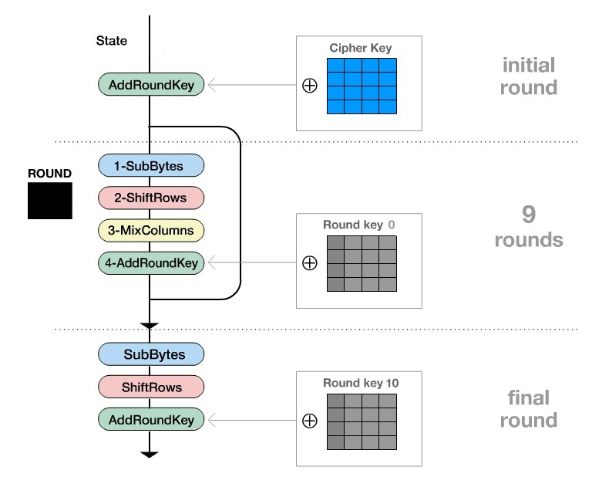

Encryption Process
9
Cipher text

Slide 17
Transformations
Sub Byte
Shift Rows
Mix Column
AddRound Key

Slide 18
1. SubByte
91 | a0 | 9a | E9
3d | F4 | C6 | F8
E3 | E2 | 8d | 48
Be | 2b | 2a | 08
91 | a0 | 9a | E9
3d | F4 | C6 | F8
E3 | E2 | 8d | 48
Be | 2b | 2a | 08
81 | a0 | 9a | E9
3d | F4 | C6 | F8
E3 | E2 | 8d | 48
Be | 2b | 2a | 08
81 | a0 | 9a | E9
3d | F4 | C6 | F8
E3 | E2 | 8d | 48
Be | 2b | 2a | 08
81 | e0 | b8 | 1e
27 | Bf | B4 | 41
11 | 98 | 5d | 52
Ae | F1 | E5 | 30
S-Box
 | 0 | 1 | 2 | 3 | 4 | 5 | 6 | 7 | 8 | 9 | A | B | C | D | e | F
00 | 63 | 7c | 77 | 7b | F2 | 6b | 6f | C5 | 30 | 01 | 67 | 2b | Fe | D7 | Ab | 76
10 | Ca | 82 | C9 | 7d | Fa | 59 | 47 | F0 | Ad | D4 | A2 | Af | 9c | A4 | 72 | C0
20 | B7 | Fd | 93 | 26 | 36 | 3f | F7 | cc | 34 | A5 | E5 | F1 | 71 | D8 | 31 | 15
30 | 04 | C7 | 23 | C3 | 18 | 96 | 05 | 9a | 07 | 12 | 80 | E2 | eb | 27 | B2 | 75
40 | 09 | 83 | 2c | 1a | 1b | 6e | 5a | A0 | 3b | D6 | B3 | 29 | E3 | 29 | 2f | 84
50 | 53 | D1 | 00 | Ed | 20 | Fc | B1 | 5b | 6a | Cb | Be | 39 | 4a | 4c | 58 | cf
60 | D0 | Ef | Aa | Fb | 43 | 4d | 33 | 85 | 45 | F9 | 02 | 7f | 50 | 3c | 9f | A8
70 | 51 | A3 | 40 | 8f | 92 | 9d | 38 | F5 | Bc | B6 | Da | 21 | 10 | Ff | F3 | D2
80 | Cd | 0c | 13 | ec | 5f | 97 | 44 | 17 | C4 | A7 | 7e | 3d | 64 | 5d | 0b | Db
90 | 60 | 81 | 4f | dc | 22 | 2a | 90 | 88 | 46 | ee | B8 | 14 | de | 5e | 0b | Db
A0 | E0 | 32 | 3a | 0a | 49 | 06 | 24 | 5c | C2 | D3 | Ac | 62 | 91 | 95 | E4 | 79
B0 | E7 | C8 | 37 | 6d | 8d | D5 | 4e | A9 | 6c | 56 | F4 | ea | 65 | 7a | ae | 08
C0 | ba | 78 | 25 | 2e | 1c | A6 | B4 | C6 | E8 | Dd | 74 | 1f | 4b | bd | 8b | 08
D0 | 70 | 3e | B5 | 66 | 48 | 03 | F6 | 0e | 61 | 35 | 57 | B9 | 86 | C1 | 1d | 9e
E0 | E1 | F8 | 98 | 11 | 69 | D9 | 8e | 94 | 9b | 1e | 87 | E9 | ce | 55 | 28 | Df
F0 | 8c | A1 | 89 | 0d | bf | E6 | 42 | 68 | 41 | 99 | 2d | 0f | B0 | 54 | bb | 16
 | 0 | 1 | 2 | 3 | 4 | 5 | 6 | 7 | 8 | 9 | A | B | C | D | e | F
00 | 63 | 7c | 77 | 7b | F2 | 6b | 6f | C5 | 30 | 01 | 67 | 2b | Fe | D7 | Ab | 76
10 | Ca | 82 | C9 | 7d | Fa | 59 | 47 | F0 | Ad | D4 | A2 | Af | 9c | A4 | 72 | C0
20 | B7 | Fd | 93 | 26 | 36 | 3f | F7 | cc | 34 | A5 | E5 | F1 | 71 | D8 | 31 | 15
30 | 04 | C7 | 23 | C3 | 18 | 96 | 05 | 9a | 07 | 12 | 80 | E2 | eb | 27 | B2 | 75
40 | 09 | 83 | 2c | 1a | 1b | 6e | 5a | A0 | 3b | D6 | B3 | 29 | E3 | 29 | 2f | 84
50 | 53 | D1 | 00 | Ed | 20 | Fc | B1 | 5b | 6a | Cb | Be | 39 | 4a | 4c | 58 | cf
60 | D0 | Ef | Aa | Fb | 43 | 4d | 33 | 85 | 45 | F9 | 02 | 7f | 50 | 3c | 9f | A8
70 | 51 | A3 | 40 | 8f | 92 | 9d | 38 | F5 | Bc | B6 | Da | 21 | 10 | Ff | F3 | D2
80 | Cd | 0c | 13 | ec | 5f | 97 | 44 | 17 | C4 | A7 | 7e | 3d | 64 | 5d | 0b | Db
90 | 60 | 81 | 4f | dc | 22 | 2a | 90 | 88 | 46 | ee | B8 | 14 | de | 5e | 0b | Db
A0 | E0 | 32 | 3a | 0a | 49 | 06 | 24 | 5c | C2 | D3 | Ac | 62 | 91 | 95 | E4 | 79
B0 | E7 | C8 | 37 | 6d | 8d | D5 | 4e | A9 | 6c | 56 | F4 | ea | 65 | 7a | ae | 08
C0 | ba | 78 | 25 | 2e | 1c | A6 | B4 | C6 | E8 | Dd | 74 | 1f | 4b | bd | 8b | 08
D0 | 70 | 3e | B5 | 66 | 48 | 03 | F6 | 0e | 61 | 35 | 57 | B9 | 86 | C1 | 1d | 9e
E0 | E1 | F8 | 98 | 11 | 69 | D9 | 8e | 94 | 9b | 1e | 87 | E9 | ce | 55 | 28 | Df
F0 | 8c | A1 | 89 | 0d | bf | E6 | 42 | 68 | 41 | 99 | 2d | 0f | B0 | 54 | bb | 16
 | 0 | 1 | 2 | 3 | 4 | 5 | 6 | 7 | 8 | 9 | A | B | C | D | e | F
00 | 63 | 7c | 77 | 7b | F2 | 6b | 6f | C5 | 30 | 01 | 67 | 2b | Fe | D7 | Ab | 76
10 | Ca | 82 | C9 | 7d | Fa | 59 | 47 | F0 | Ad | D4 | A2 | Af | 9c | A4 | 72 | C0
20 | B7 | Fd | 93 | 26 | 36 | 3f | F7 | cc | 34 | A5 | E5 | F1 | 71 | D8 | 31 | 15
30 | 04 | C7 | 23 | C3 | 18 | 96 | 05 | 9a | 07 | 12 | 80 | E2 | eb | 27 | B2 | 75
40 | 09 | 83 | 2c | 1a | 1b | 6e | 5a | A0 | 3b | D6 | B3 | 29 | E3 | 29 | 2f | 84
50 | 53 | D1 | 00 | Ed | 20 | Fc | B1 | 5b | 6a | Cb | Be | 39 | 4a | 4c | 58 | cf
60 | D0 | Ef | Aa | Fb | 43 | 4d | 33 | 85 | 45 | F9 | 02 | 7f | 50 | 3c | 9f | A8
70 | 51 | A3 | 40 | 8f | 92 | 9d | 38 | F5 | Bc | B6 | Da | 21 | 10 | Ff | F3 | D2
80 | Cd | 0c | 13 | ec | 5f | 97 | 44 | 17 | C4 | A7 | 7e | 3d | 64 | 5d | 0b | Db
90 | 60 | 81 | 4f | dc | 22 | 2a | 90 | 88 | 46 | ee | B8 | 14 | de | 5e | 0b | Db
A0 | E0 | 32 | 3a | 0a | 49 | 06 | 24 | 5c | C2 | D3 | Ac | 62 | 91 | 95 | E4 | 79
B0 | E7 | C8 | 37 | 6d | 8d | D5 | 4e | A9 | 6c | 56 | F4 | ea | 65 | 7a | ae | 08
C0 | ba | 78 | 25 | 2e | 1c | A6 | B4 | C6 | E8 | Dd | 74 | 1f | 4b | bd | 8b | 08
D0 | 70 | 3e | B5 | 66 | 48 | 03 | F6 | 0e | 61 | 35 | 57 | B9 | 86 | C1 | 1d | 9e
E0 | E1 | F8 | 98 | 11 | 69 | D9 | 8e | 94 | 9b | 1e | 87 | E9 | ce | 55 | 28 | Df
F0 | 8c | A1 | 89 | 0d | bf | E6 | 42 | 68 | 41 | 99 | 2d | 0f | B0 | 54 | bb | 16
 | 0 | 1 | 2 | 3 | 4 | 5 | 6 | 7 | 8 | 9 | A | B | C | D | e | F
00 | 63 | 7c | 77 | 7b | F2 | 6b | 6f | C5 | 30 | 01 | 67 | 2b | Fe | D7 | Ab | 76
10 | Ca | 82 | C9 | 7d | Fa | 59 | 47 | F0 | Ad | D4 | A2 | Af | 9c | A4 | 72 | C0
20 | B7 | Fd | 93 | 26 | 36 | 3f | F7 | cc | 34 | A5 | E5 | F1 | 71 | D8 | 31 | 15
30 | 04 | C7 | 23 | C3 | 18 | 96 | 05 | 9a | 07 | 12 | 80 | E2 | eb | 27 | B2 | 75
40 | 09 | 83 | 2c | 1a | 1b | 6e | 5a | A0 | 3b | D6 | B3 | 29 | E3 | 29 | 2f | 84
50 | 53 | D1 | 00 | Ed | 20 | Fc | B1 | 5b | 6a | Cb | Be | 39 | 4a | 4c | 58 | cf
60 | D0 | Ef | Aa | Fb | 43 | 4d | 33 | 85 | 45 | F9 | 02 | 7f | 50 | 3c | 9f | A8
70 | 51 | A3 | 40 | 8f | 92 | 9d | 38 | F5 | Bc | B6 | Da | 21 | 10 | Ff | F3 | D2
80 | Cd | 0c | 13 | ec | 5f | 97 | 44 | 17 | C4 | A7 | 7e | 3d | 64 | 5d | 0b | Db
90 | 60 | 81 | 4f | dc | 22 | 2a | 90 | 88 | 46 | ee | B8 | 14 | de | 5e | 0b | Db
A0 | E0 | 32 | 3a | 0a | 49 | 06 | 24 | 5c | C2 | D3 | Ac | 62 | 91 | 95 | E4 | 79
B0 | E7 | C8 | 37 | 6d | 8d | D5 | 4e | A9 | 6c | 56 | F4 | ea | 65 | 7a | ae | 08
C0 | ba | 78 | 25 | 2e | 1c | A6 | B4 | C6 | E8 | Dd | 74 | 1f | 4b | bd | 8b | 08
D0 | 70 | 3e | B5 | 66 | 48 | 03 | F6 | 0e | 61 | 35 | 57 | B9 | 86 | C1 | 1d | 9e
E0 | E1 | F8 | 98 | 11 | 69 | D9 | 8e | 94 | 9b | 1e | 87 | E9 | ce | 55 | 28 | Df
F0 | 8c | A1 | 89 | 0d | bf | E6 | 42 | 68 | 41 | 99 | 2d | 0f | B0 | 54 | bb | 16

Slide 19
2. Shift Row
81 | e0 | b8 | 1e
27 | Bf | B4 | 41
11 | 98 | 5d | 52
Ae | F1 | E5 | 30
81 | e0 | b8 | 1e
41 | Bf | B4 | 27
11 | 98 | 5d | 52
Ae | F1 | E5 | 30
81 | e0 | b8 | 1e
41 | Bf | B4 | 27
5d | 52 | 11 | 98
Ae | F1 | E5 | 30
81 | e0 | b8 | 1e
41 | Bf | B4 | 27
5d | 52 | 11 | 98
Ae | F1 | E5 | 30
81 | e0 | b8 | 1e
41 | Bf | B4 | 27
5d | 52 | 11 | 98
30 | Ae | F1 | E5
81 | e0 | b8 | 1e
41 | Bf | B4 | 27
11 | 98 | 5d | 52
Ae | F1 | E5 | 30
Shift 1 Byte
Shift 2 Byte
Shift 3 Byte

Slide 20
3. Mix Columns
04 | E0 | 48 | 28
66 | Cb | F8 | 06
81 | 19 | D3 | 26
e5 | 9a | 7a | 4c
81 | e0 | b8 | 1e
41 | Bf | B4 | 27
5d | 52 | 11 | 98
30 | Ae | F1 | E5
04 | e0 | b8 | 1e
66 | Bf | B4 | 27
81 | 52 | 11 | 98
e5 | Ae | F1 | E5
81 | e0 | b8 | 1e
41 | Bf | B4 | 27
5d | 52 | 11 | 98
30 | Ae | F1 | E5
81
41
5d
30
02 | 03 | 01 | 01
01 | 02 | 03 | 01
01 | 01 | 02 | 03
03 | 01 | 01 | 02
04
66
81
e5

Slide 21
4. AddRound Key
Round Key
04 | E0 | 48 | 28
66 | Cb | F8 | 06
81 | 19 | D3 | 26
e5 | 9a | 7a | 4c
04 | E0 | 48 | 28
66 | Cb | F8 | 06
81 | 19 | D3 | 26
e5 | 9a | 7a | 4c
A4 | E0 | 48 | 28
9c | Cb | F8 | 06
7f | 19 | D3 | 26
f2 | 9a | 7a | 4c
A4 | 68 | 6b | 02
9c | 9f | 5b | 6a
7f | 35 | Ea | 50
f2 | 2b | 43 | 49
A0 | 88 | 23 | 2a
Fa | 54 | A3 | 6c
Fe | 2c | 39 | 76
17 | B1 | 39 | 05
A0 | 88 | 23 | 2a
Fa | 54 | A3 | 6c
Fe | 2c | 39 | 76
17 | B1 | 39 | 05
O4
66
81
e5
A0
Fa
Fe
17
A4
9c
7f
f2

Slide 22
This Transformation are applied to 9 Rounds.
The Final Round does not contain Mix Column Transform

Slide 23
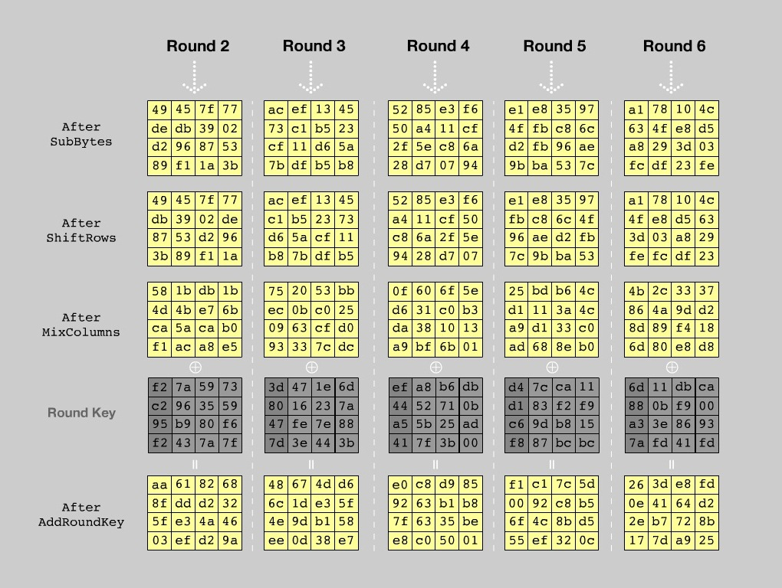

Slide 24
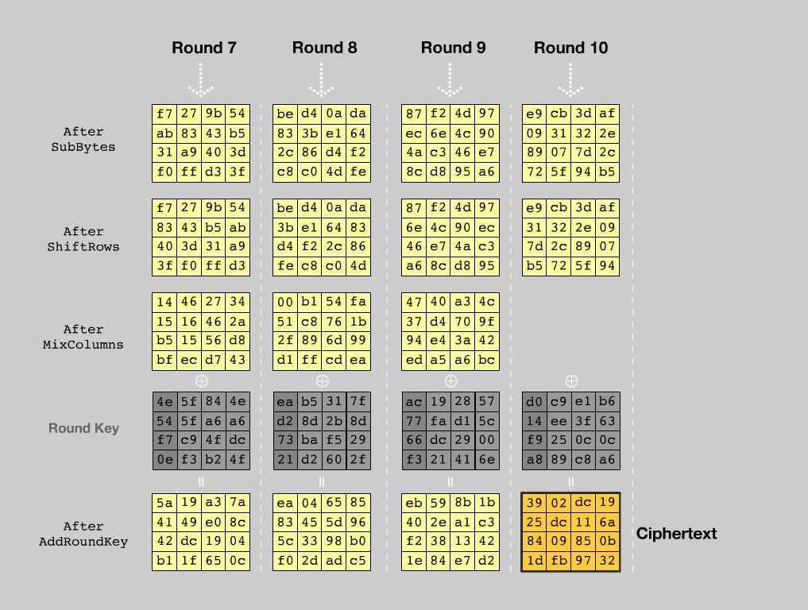

Slide 25
Key
Schedule

Slide 26
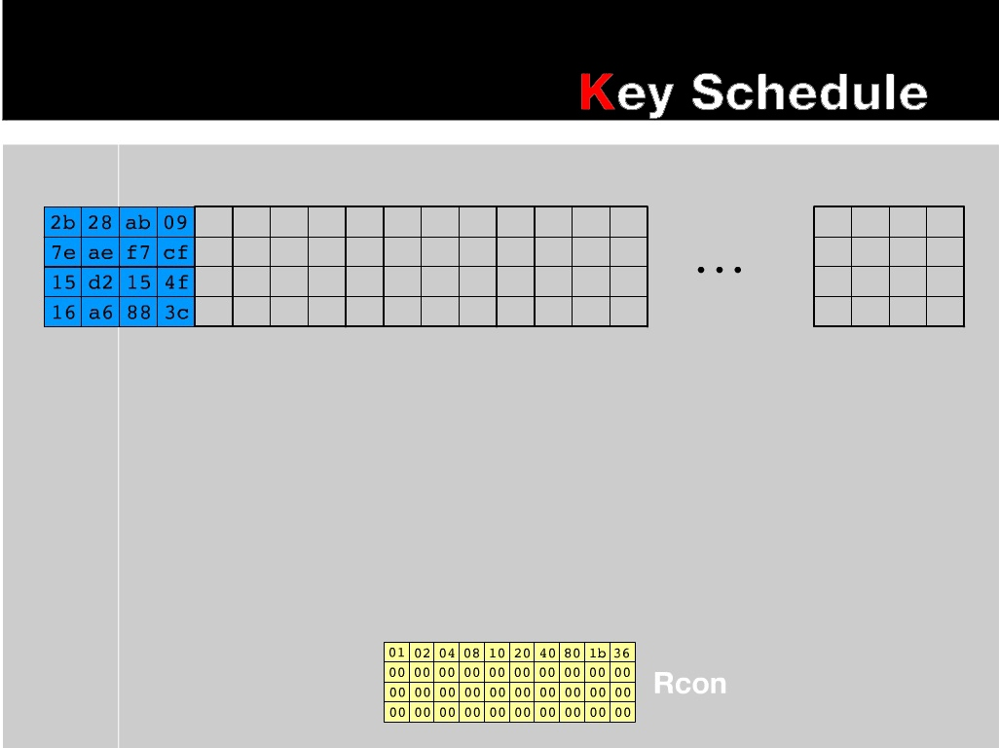

Slide 27
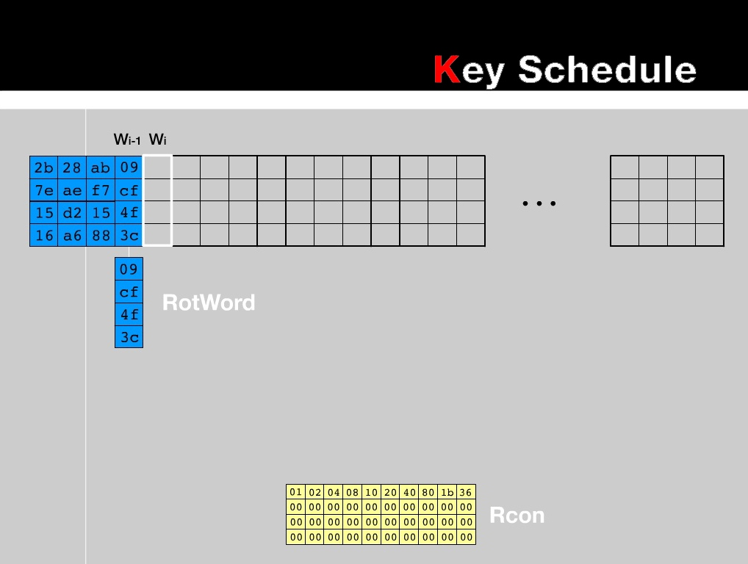

Slide 28
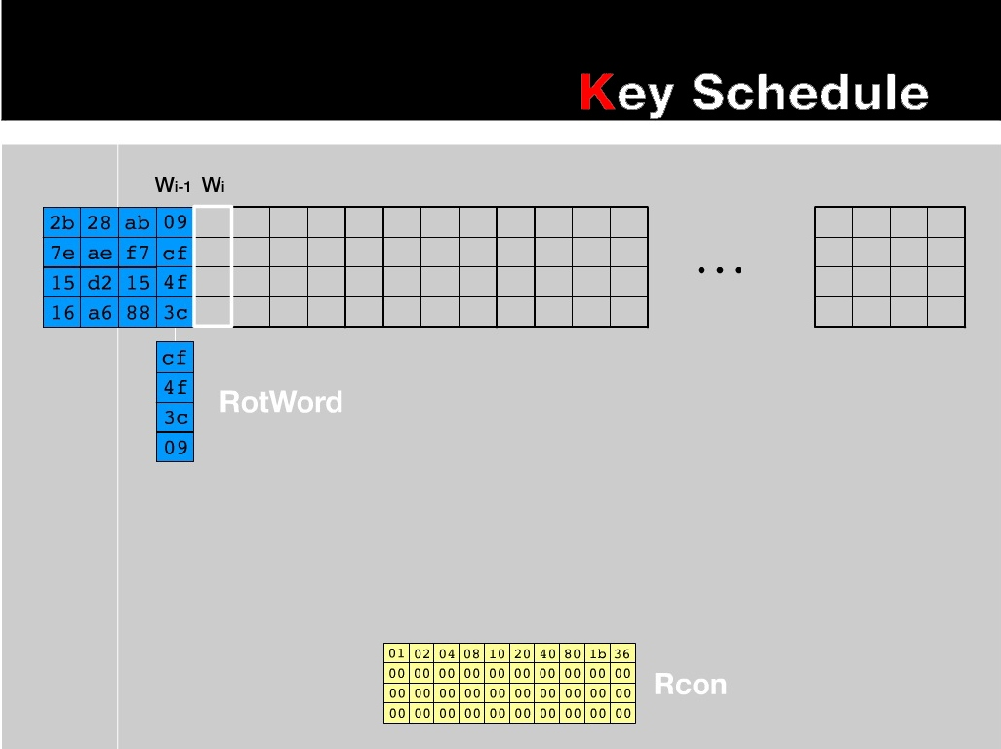

Slide 29
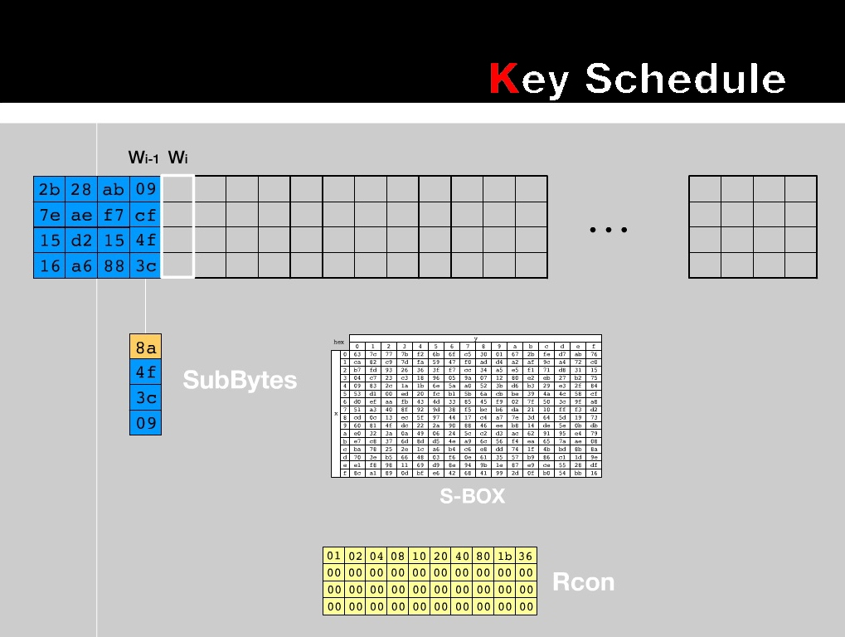

Slide 30
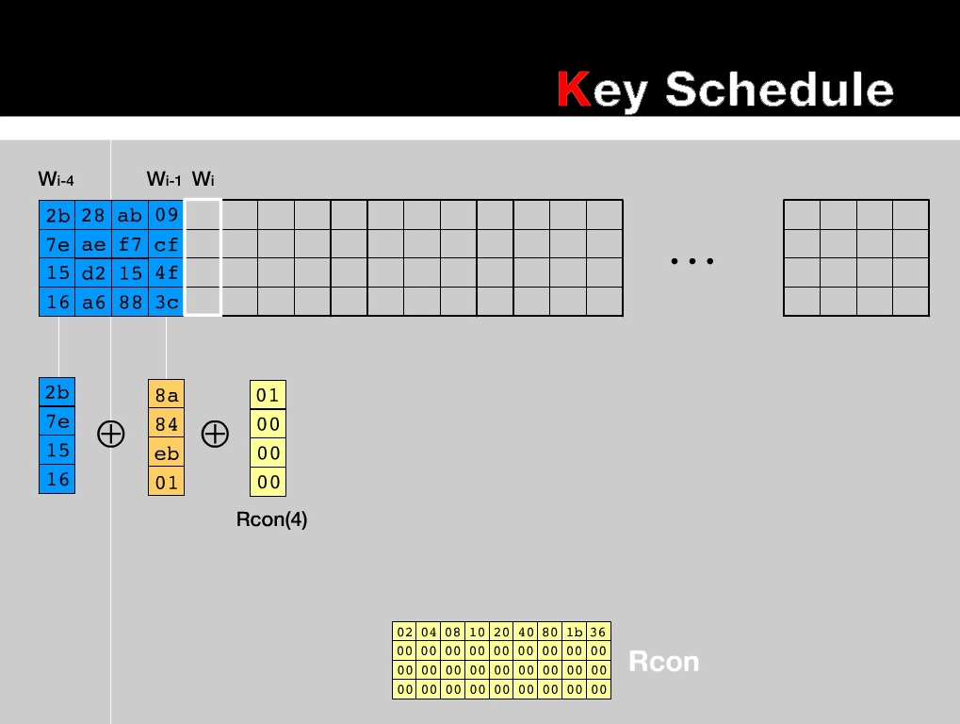

Slide 31
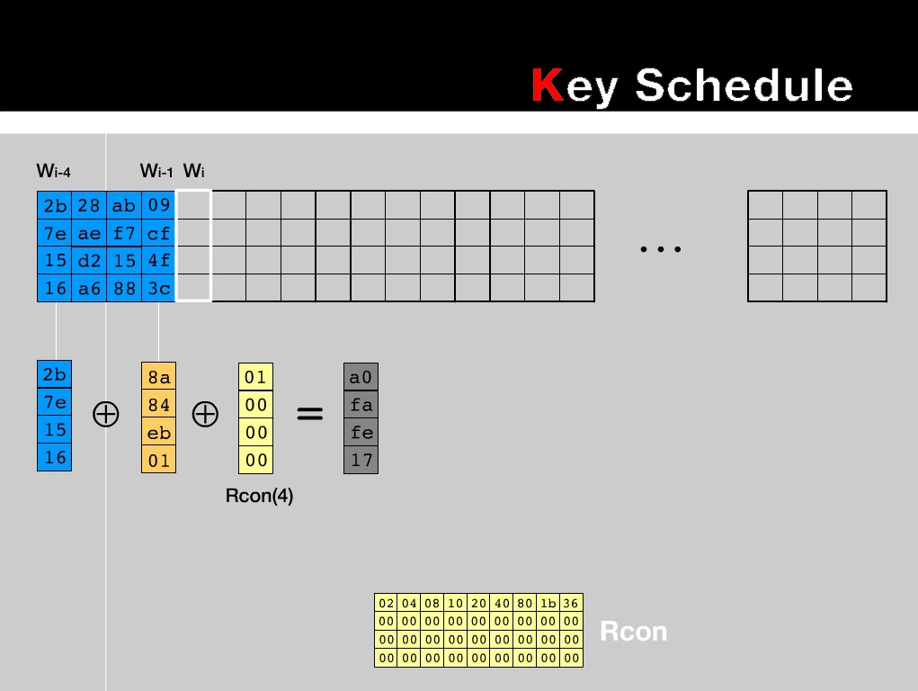

Slide 32
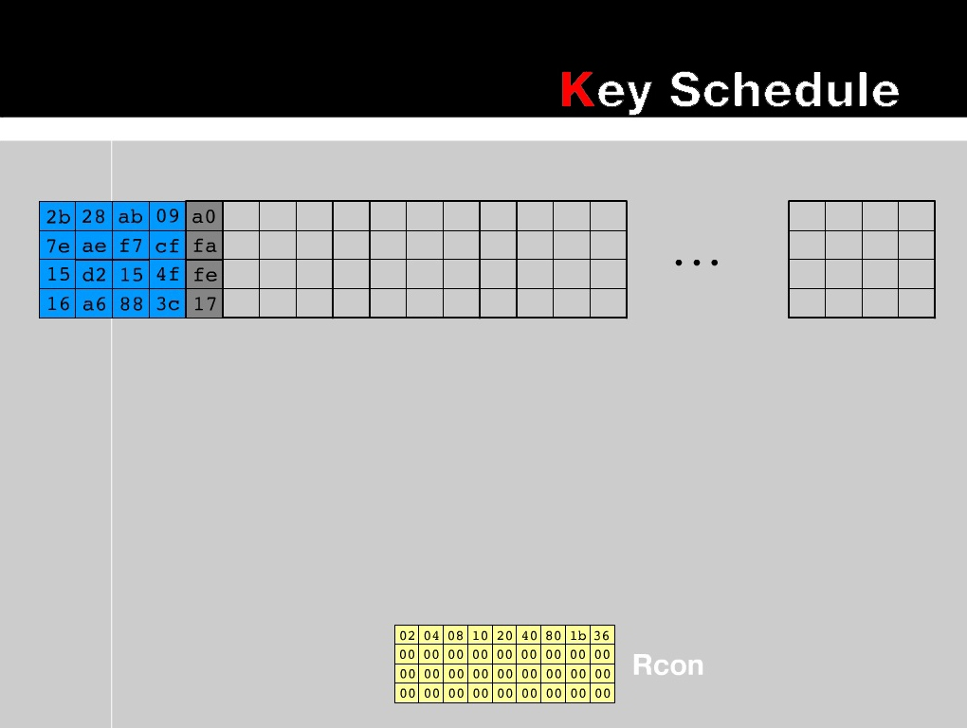

Slide 33
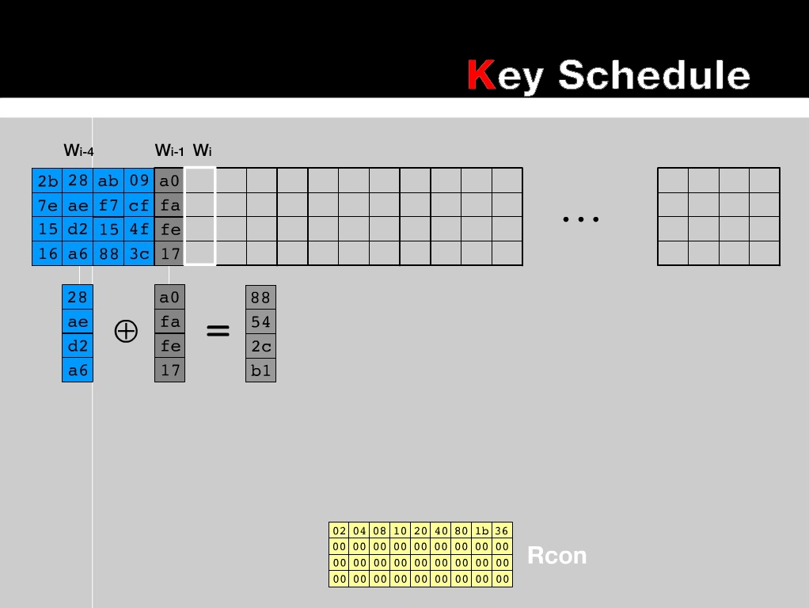

Slide 34
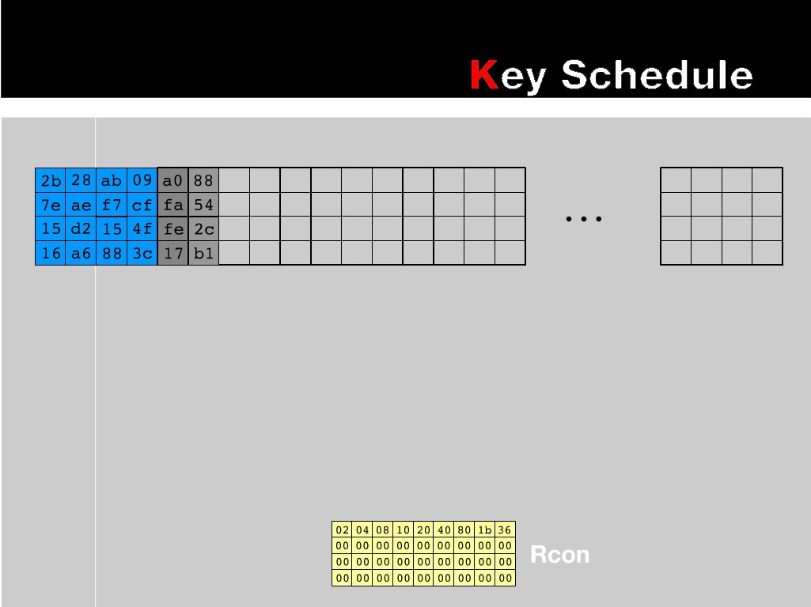

Slide 35
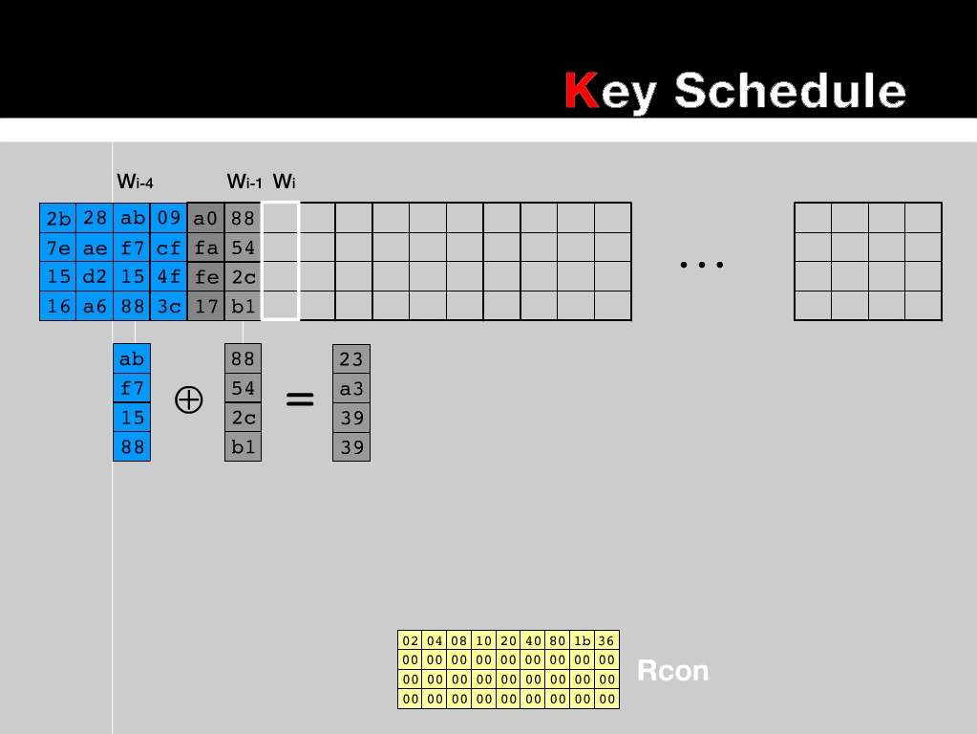

Slide 36
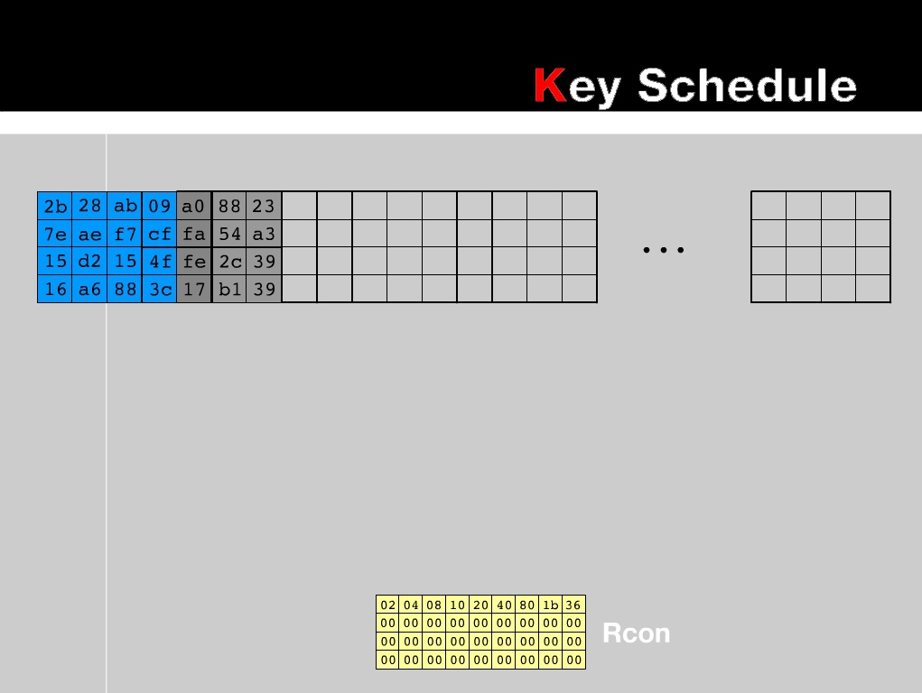

Slide 37
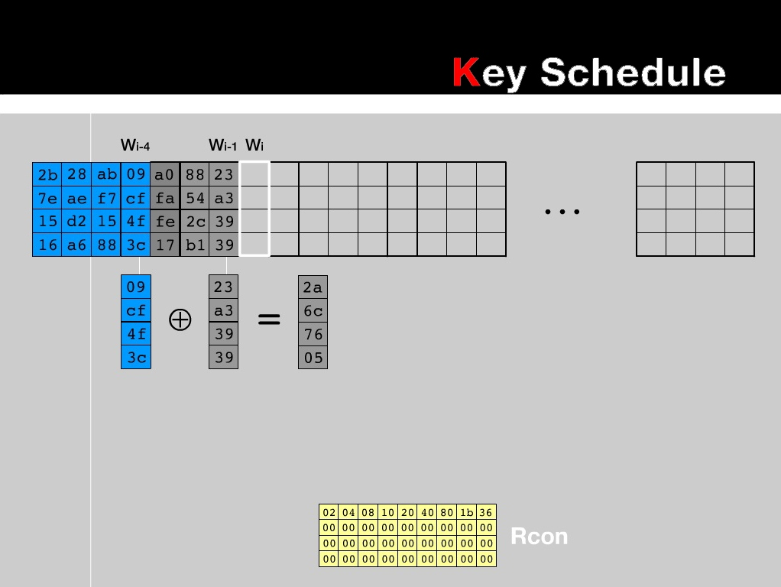

Slide 38
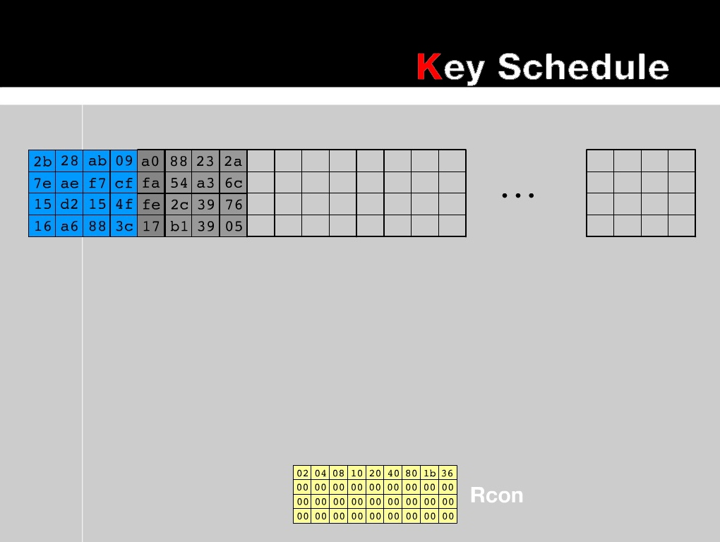

Slide 39
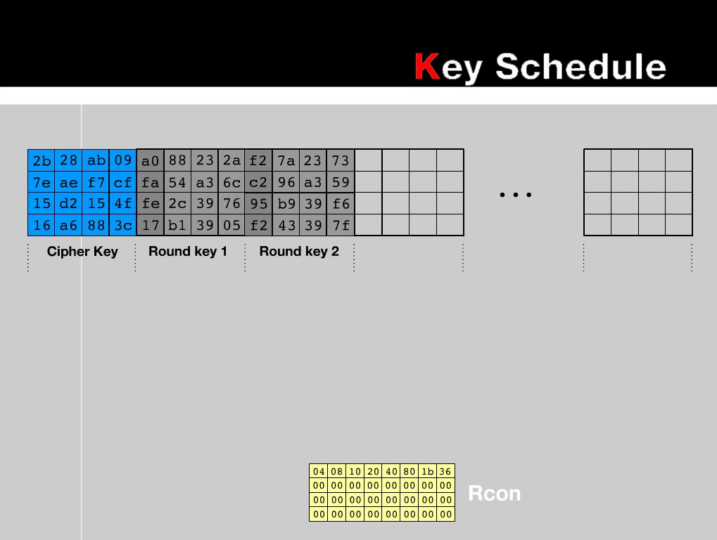

Slide 40
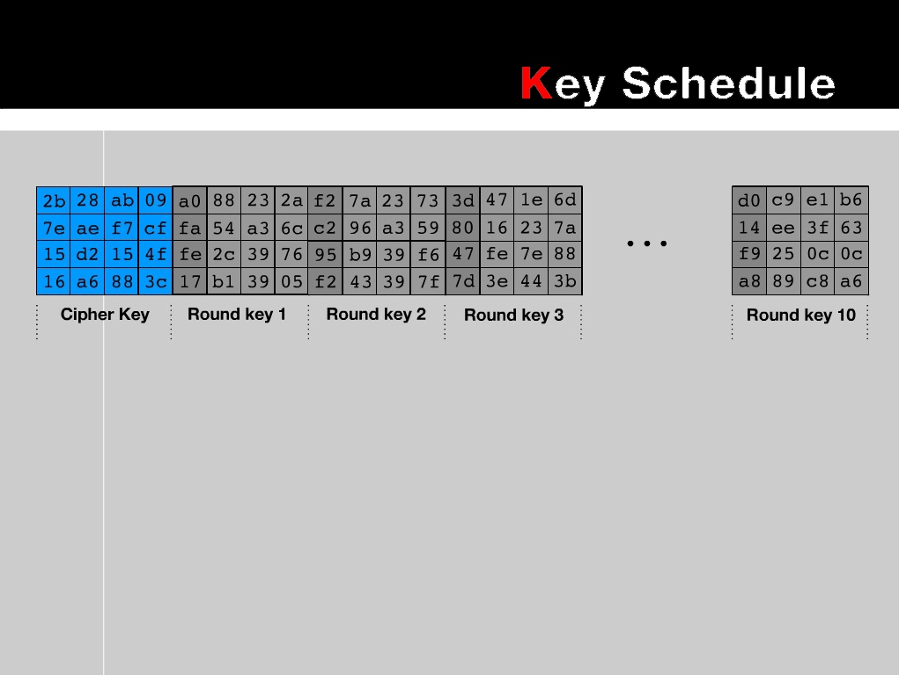

Slide 41
Algorithm
Rijndael ( State, CipherKey)
{
KeyExpansion(CipherKey,ExpandedKey);
AddRoundKey( CipherKey, ExtendedKey);
For(i=1 ; i<Nr-1 ; i++)
{
Round(State,RoundKey);
}
FinalRoundKey(State,ExpandedKey+Nb*Nr);
}

Slide 42
Algorithm
Round(State,RoundKey)
{
ByteSub(State);
ShiftRow(State);
MixColumn(State);
AddRoundKey(State);
}

Slide 43
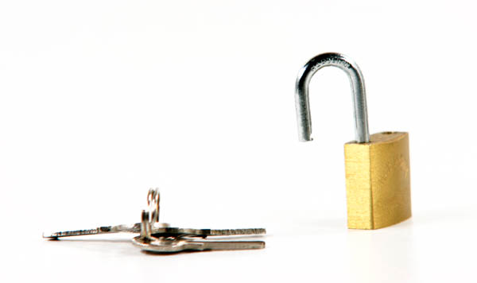
Decryption Process
Initial Round
AddRoundKey
Decryption Round
InvShiftRows
InvSubBytes
InvMixcolumns
AddRoundKey
Final Round
InvShiftRows
InvSubBytes
AddRoundKey

Slide 44
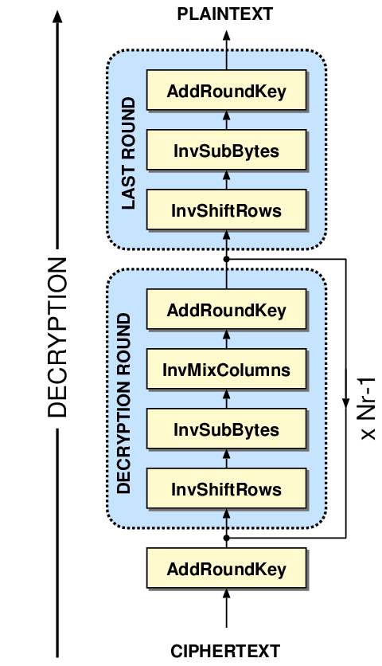

Slide 45
Algorithm
InvRound(State,ExpandedKey[i])
{
InvAddRoundKey(State,ExpandedKey[i]);
InvMixColumn(State);
InvShiftRow(State);
InvByteSub(State);
}

Slide 46
Strength of Rijndael
Rich algebraic structure
Low memory Requirement
Resistance from Brute Froce

Slide 47
Index
Introduction
Data Encryption Standard
Advanced Encryption Standard
Rijndael
Encryption Algorithm
Decryption Algorithm
Strength
Conclusion

Slide 48
Conclusion

Slide 49

T H A N K Y O U

